Slide 1


DEPARTMENT OF COMPUTER SCIENCE AND ENGINEERING
CMR TECHNICAL CAMPUS
UGC AUTONOMOUS
A MAJOR PROJECT ON
Fake Profile Identification in Social Network using Machine Learning and NLP
Under the Guidance of
RANJITH REDDY K
(Assistant Professor)
Presented by :-
V GOPI SINGH 217R5A0523
THIPPAMOLA MAHESH 207R1A05P3
PATHURI SHRUTHI REDDY 207R1A05M7

Slide 2
Content
Modules
Conclusion
Future Scope
References
Introduction [Abstract]
Existing System
Disadvantages
Proposed System
Advantages
Hardware requirements
Software requirements
Novelty of project
Architecture

Slide 3
Introduction to Project
At present social network sites are part of the life for most of the people. The social network sites not only providing advantages to the users but also provide security issues to the users as well as their information. To analyse, who are encouraging threats in social network we need to classify the social networks profiles of the users. From the classification, we can get the genuine profiles and fake profiles on the social networks.
In this project we are proposing Machine learning and Natural language Processing (NLP) techniques to improve the accuracy rate of the fake profiles detection. We can use the Support Vector Machine (SVM) and Naive Bayes algorithm.

Slide 4
Existing System
1. Identifying Fake Profiles in LinkedIn
Focuses on detecting fake profiles in LinkedIn by identifying minimal profile data necessary for identification. Proposes a data mining approach achieving high accuracy rates. It is developed by Shalinda Adikari, Kaushik Dutta.
2. Method for Detecting Spammers and Fake Profiles in Social Networks
Presents a method for detecting spammers and fake profiles in social networks using supervised learning classifiers trained on negative and positive examples. It is developed by Yuval Elovici, Michael FIRE, Gilad Katz.

Slide 5
Disadvantages of existing system
The system is not implemented Learning Algorithms like svm, Naive Bayes.
The system is not implemented any the problems involving social networking like privacy, online bullying, misuse, and trolling and many others.

Slide 6
Proposed System
The proposed system employs machine learning and natural language processing to identify false profiles in online social networks. It integrates SVM and Naïve Bayes algorithms to enhance detection accuracy.
SVM separates data using an optimal hyperplane, while Naïve Bayes calculates the likelihood of object features belonging to a specific category. Despite Naïve Bayes' assumption of feature independence, it effectively predicts false profiles based on attributes like time, date of publication, posts, language, and geoposition.
This comprehensive approach aims to improve accuracy in detecting fake profiles by considering multiple characteristics indicative of deceptive behavior in social network profiles.

Slide 7
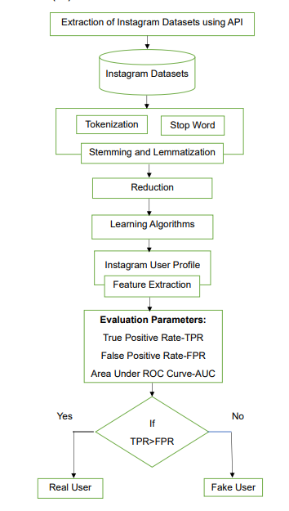

Slide 8
Advantages of proposed system
Accuracy is high when compared to the existing system.
Fully secure and easily detect the fake profile in social networks.
Time consumption for detecting the fake profiles.
In the proposed system, Social Networking offerings have facilitated identity theft and Impersonation attacks for serious as good as naïve attackers.

Slide 9
HARDWARE REQUIREMENTS
Processor - Pentium –IV or higher
RAM - 4 GB (min)
Hard Disk - 20 GB

Slide 10
SOFTWARE REQUIREMENTS
Operating system : Windows 7 Ultimate.
Coding Language : Python.
Front-End / Designing : Html, CSS, JavaScript.
Frame Work : Django-ORM.
Data Base : MySQL (WAMP Server).

Slide 11
Novelty of Project
The novelty of fake profile detection using machine learning and NLP lies in its ability to leverage advanced algorithms, multimodal analysis, scalability, and interdisciplinary collaboration to effectively identify deceptive behavior in online social networks.

Slide 12
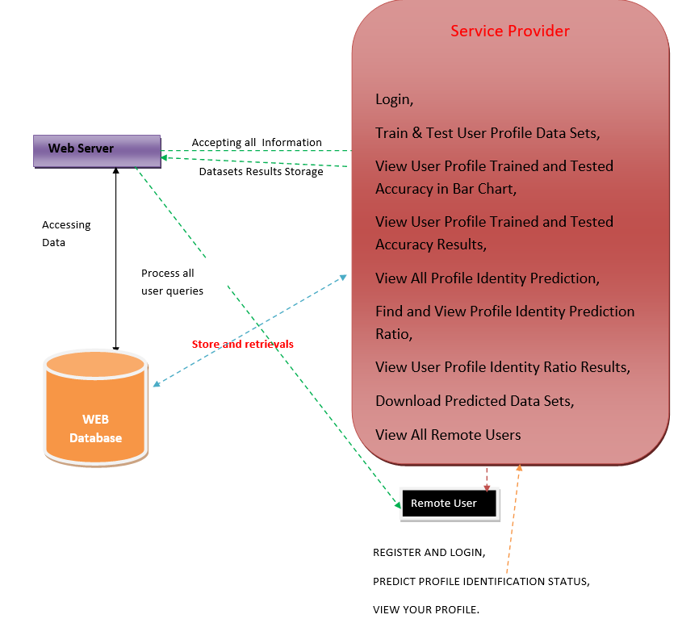
Architecture

Slide 13
Modules
Remote User
Service Provider
View and Authorize Users

Slide 14
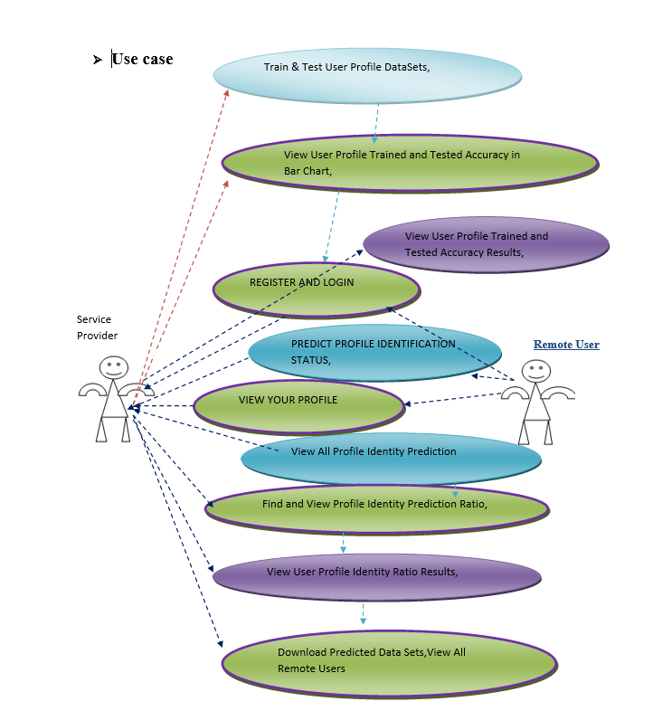
Use case diagram :-
UML DIAGRAMS

Slide 15
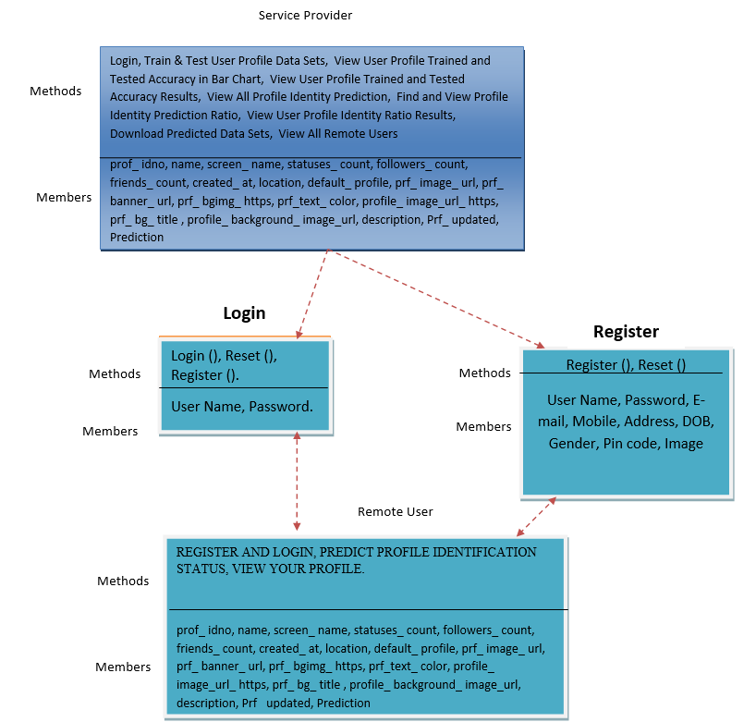
Class Diagram :-

Slide 16
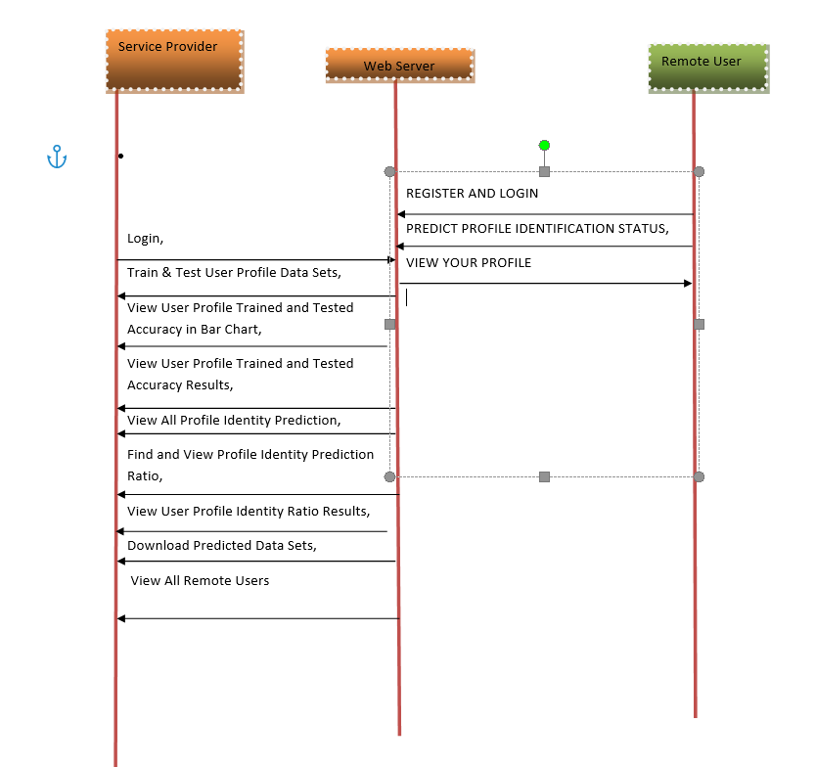
Sequence Diagram :-

Slide 17
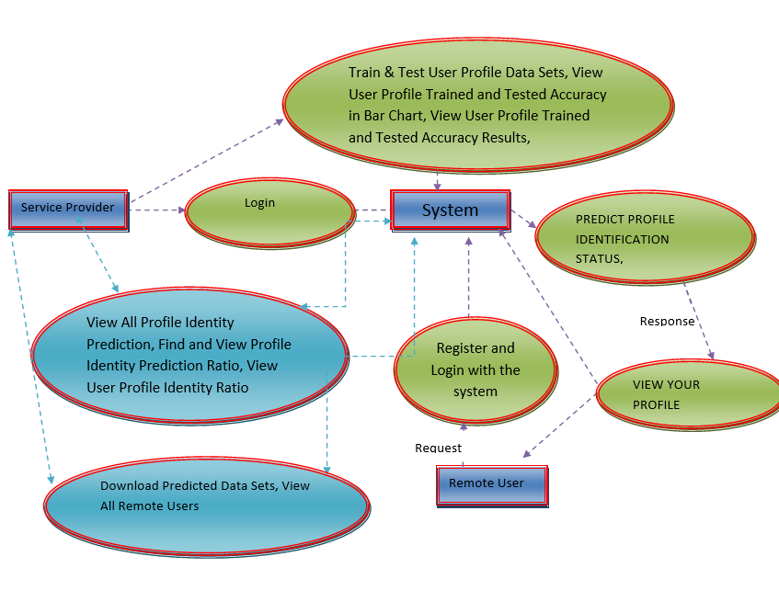
Data Flow Diagram :-

Slide 18
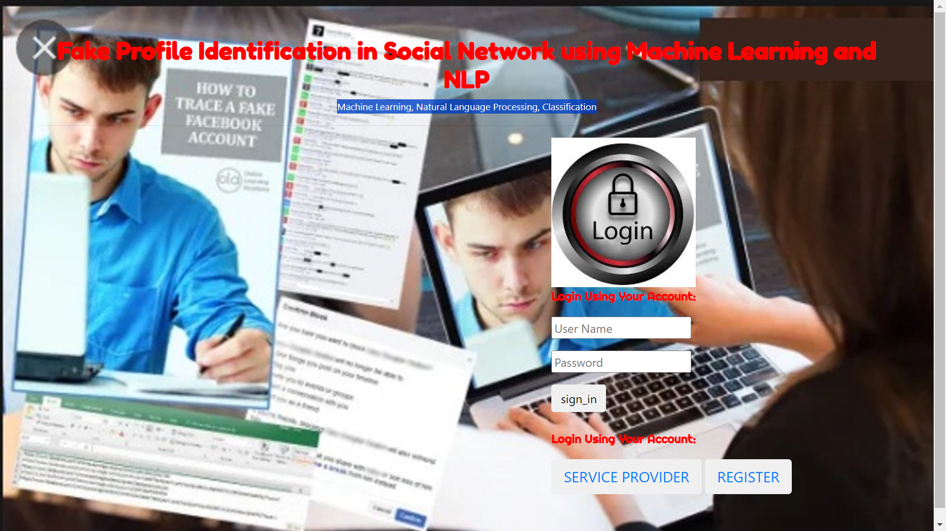
Screen shots
Remote User Interface:-

Slide 19
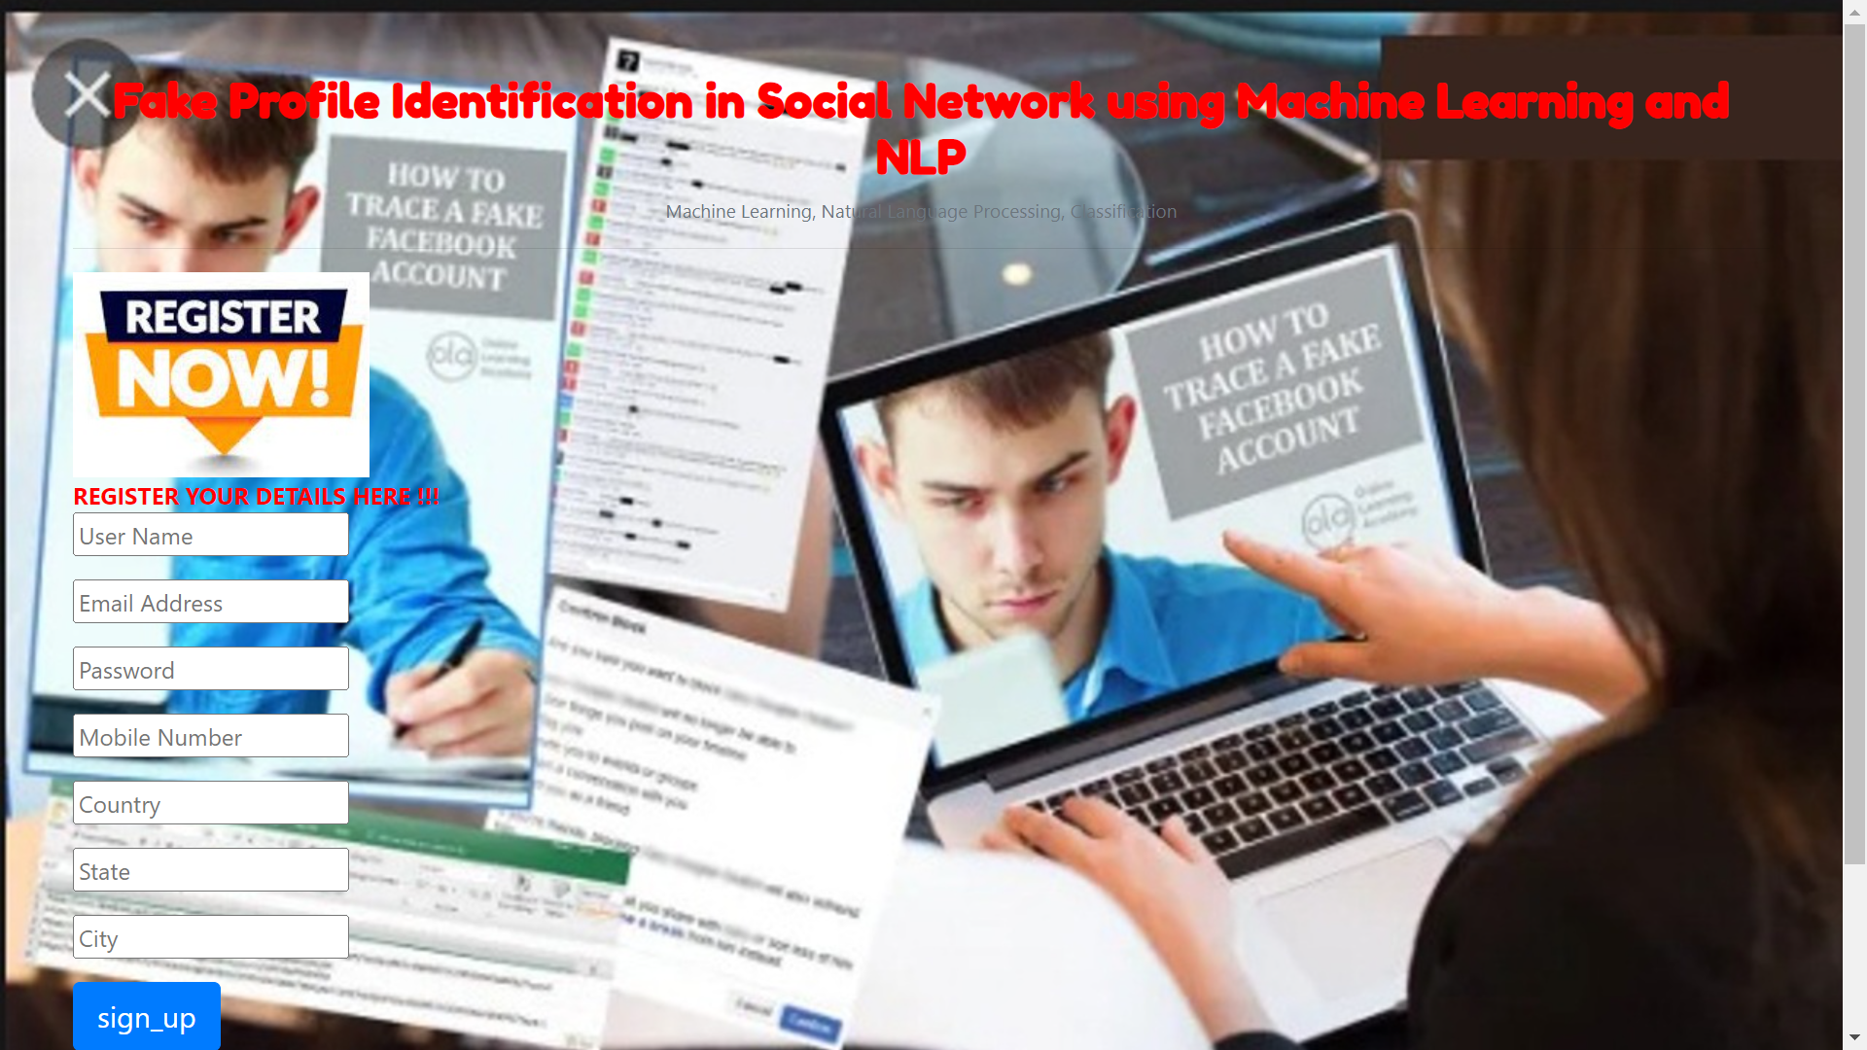
Register Here :-

Slide 20
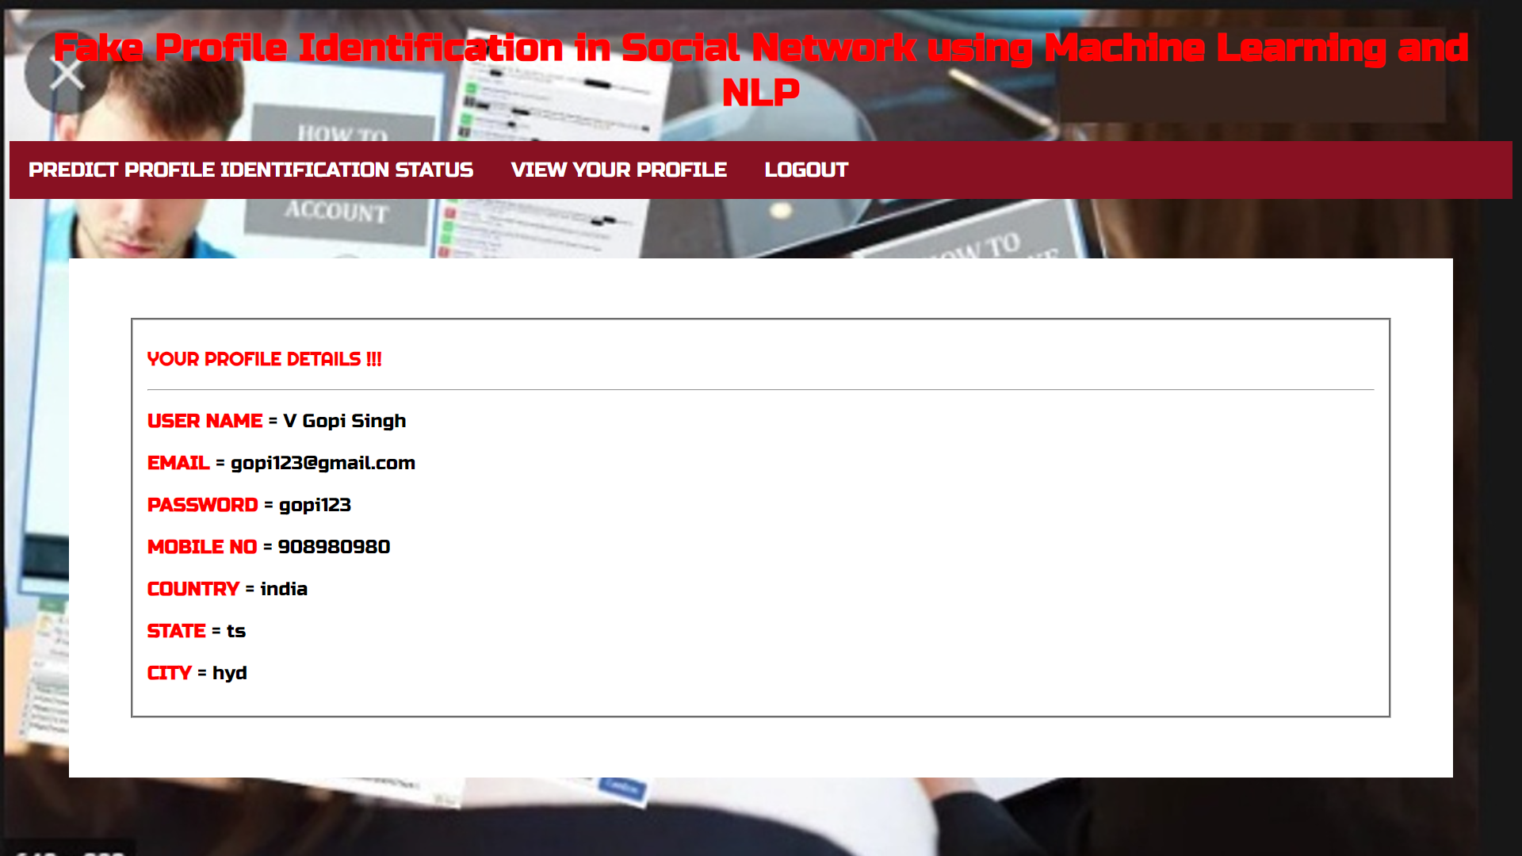
User Profile Details After Registration :-

Slide 21
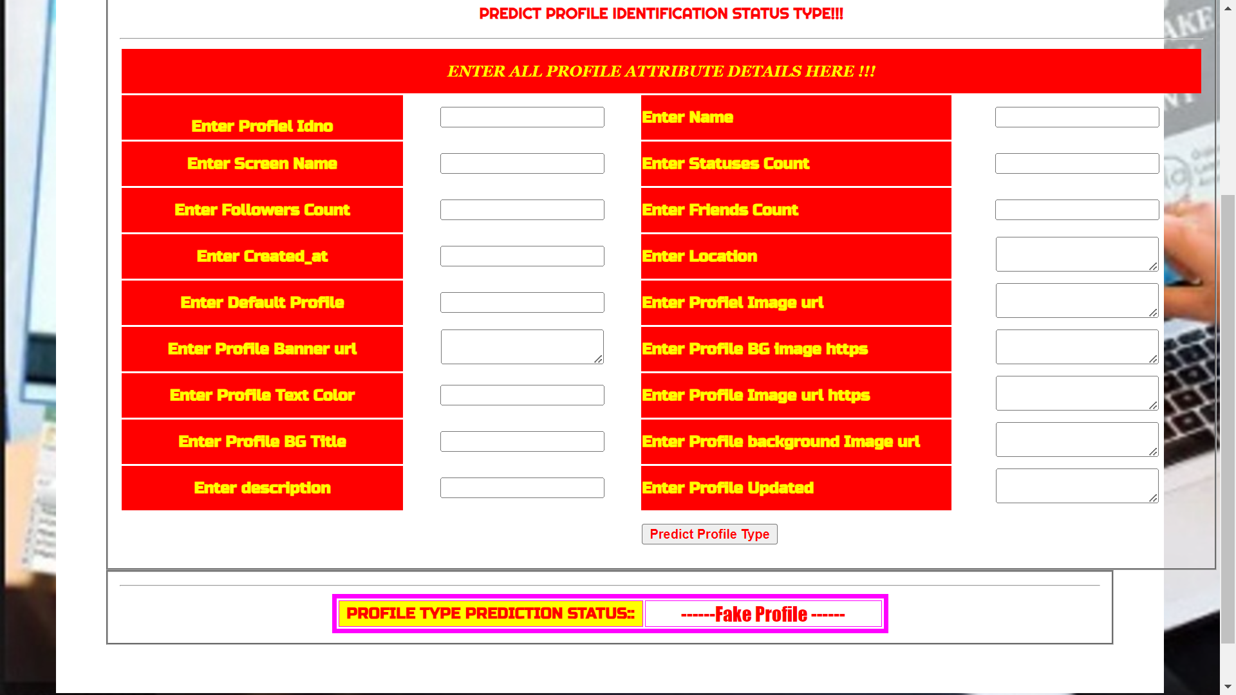
Predict Profile Whether Genuine Or Fake :-

Slide 22
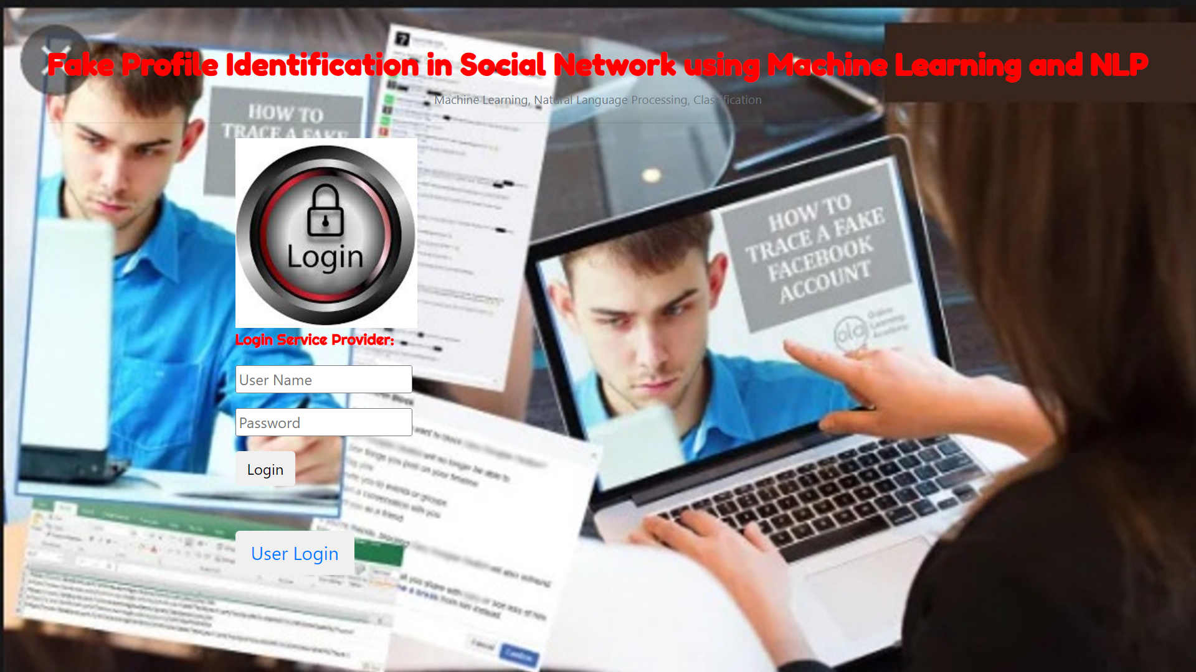
Service Provider login Interface :-

Slide 23
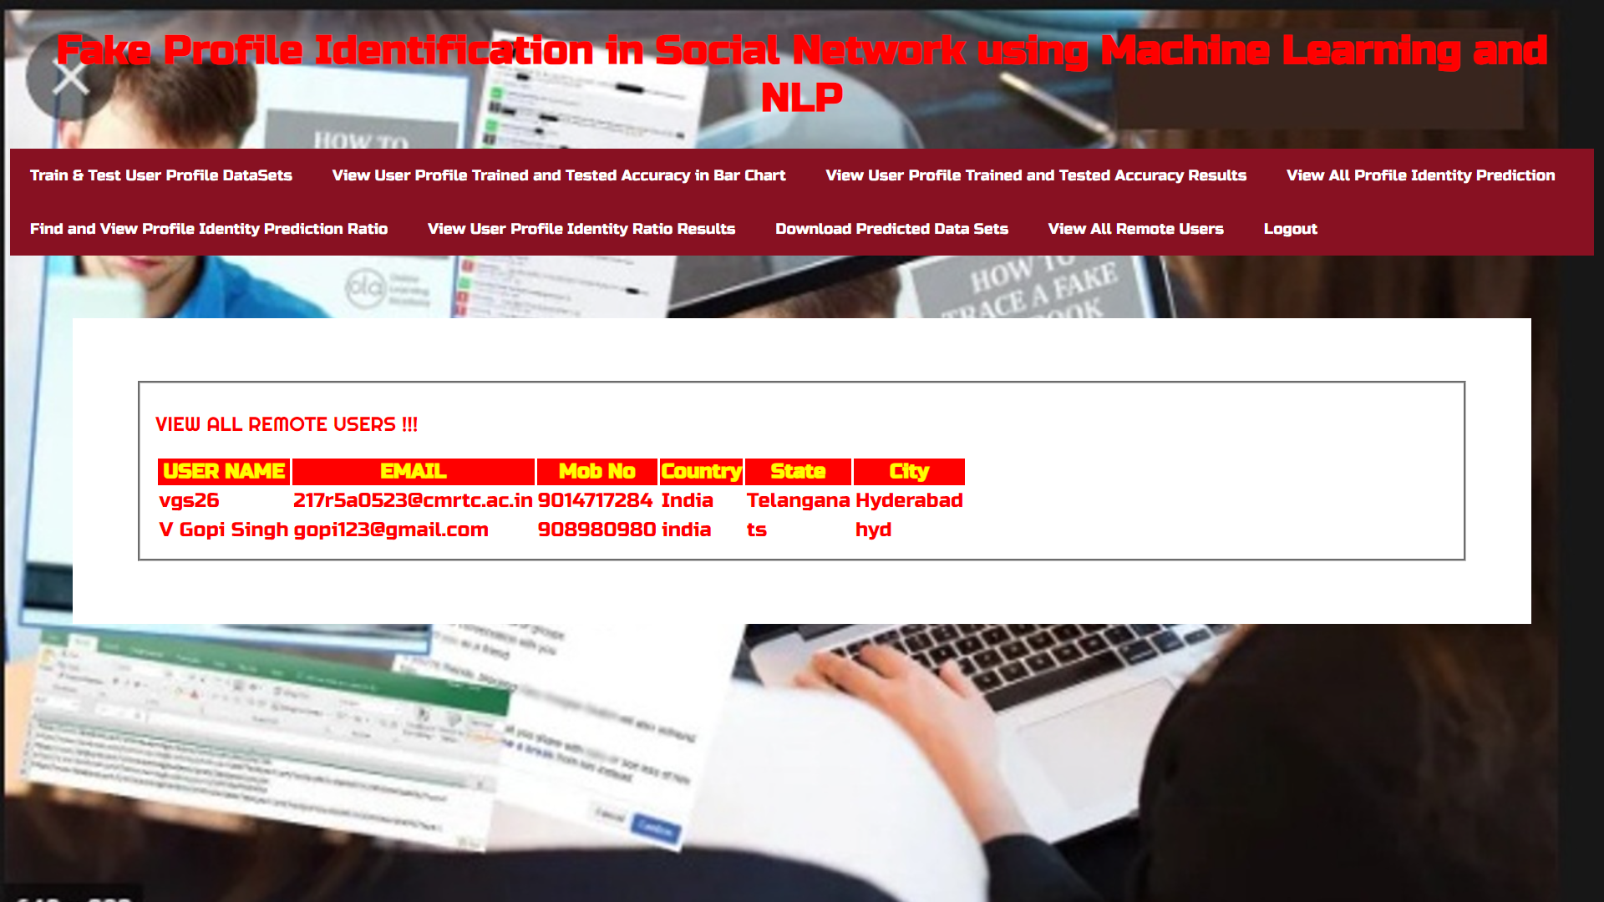
All Remote Users Details Who Registered :-

Slide 24
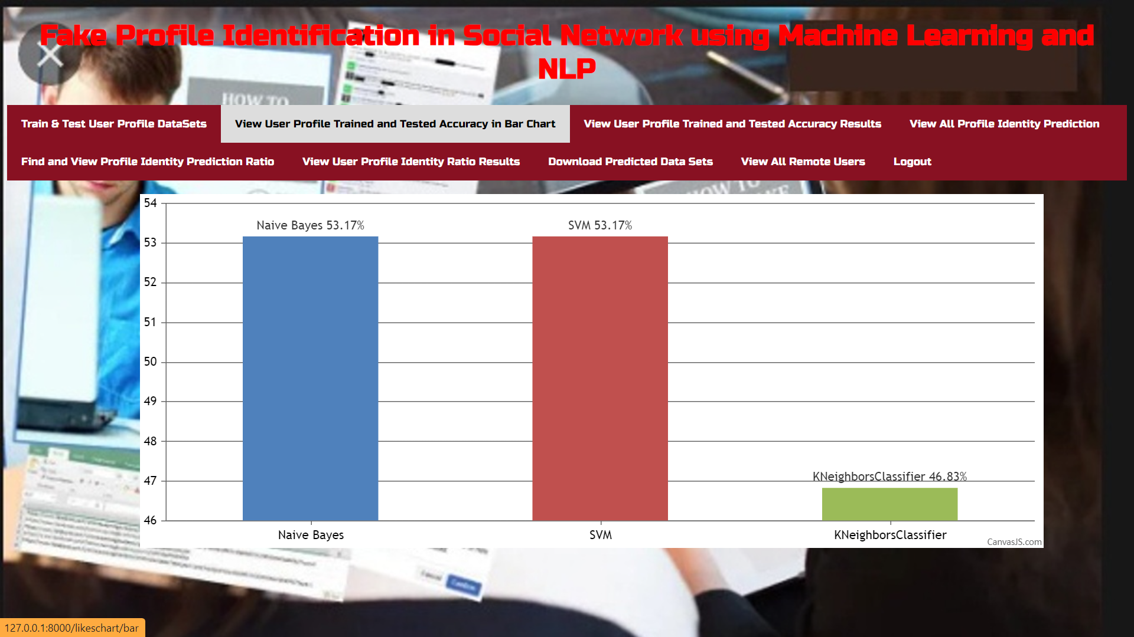
User Profile Trained And Test Accuracy In Bar Chart :-

Slide 25
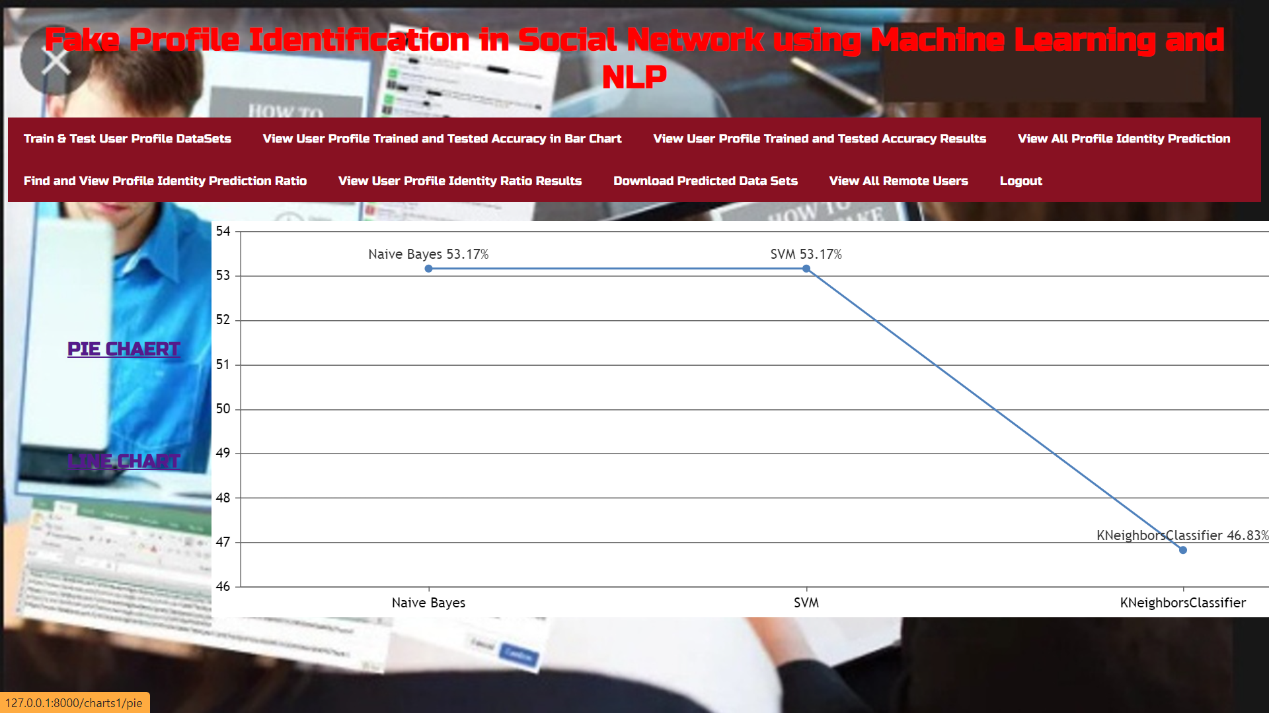
User Profile Trained And Test Accuracy In Line Chart :-

Slide 26
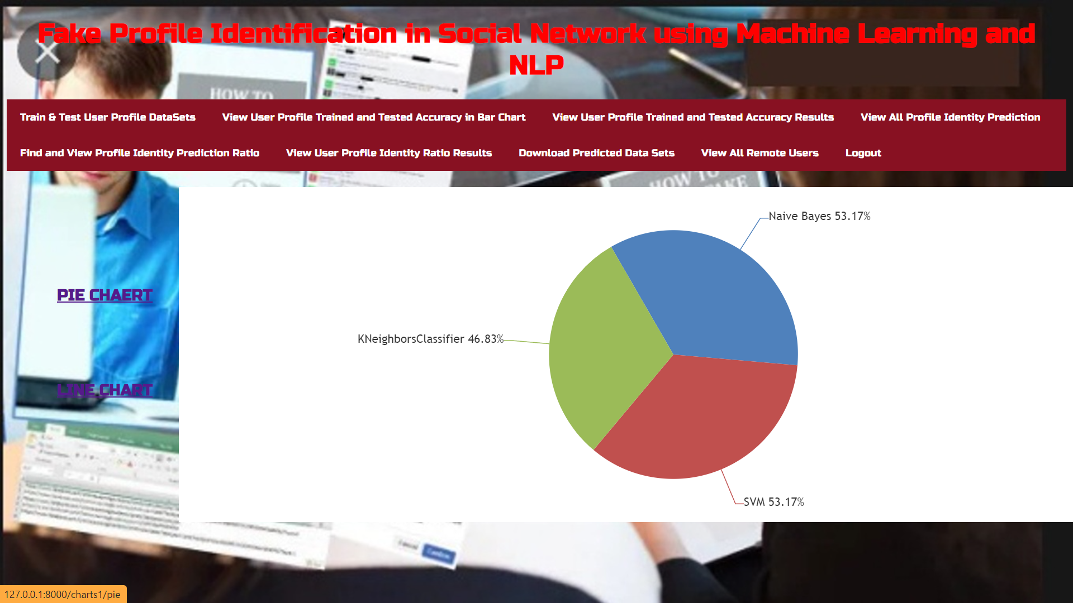
User Profile Trained And Test Accuracy In Pie Chart :-

Slide 27
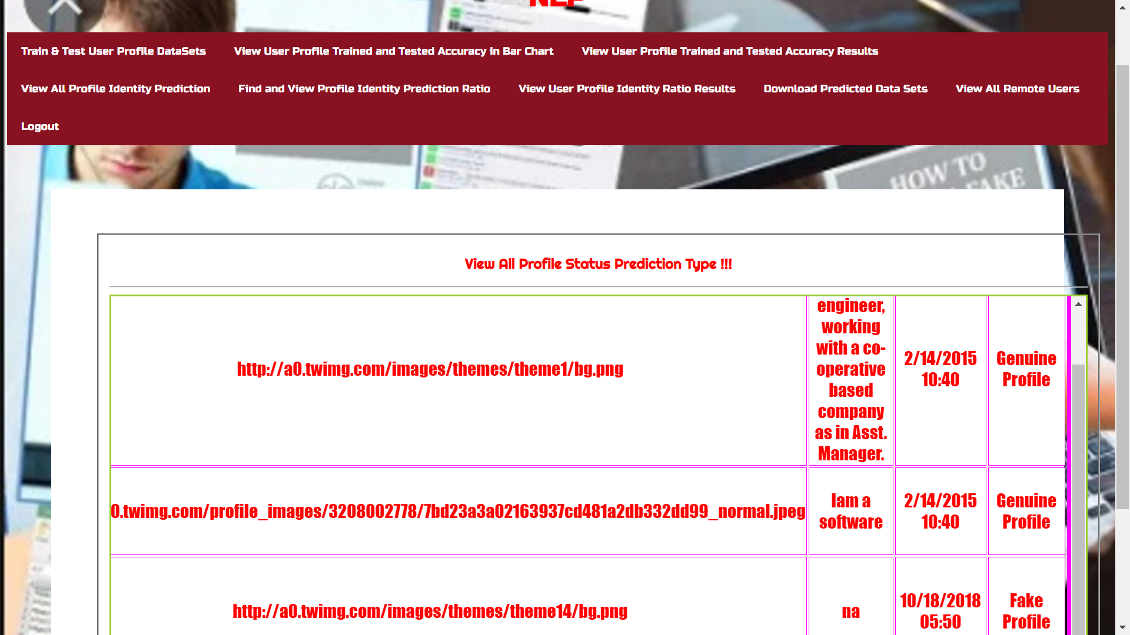
All Profiles Status That Are Predicted :-

Slide 28
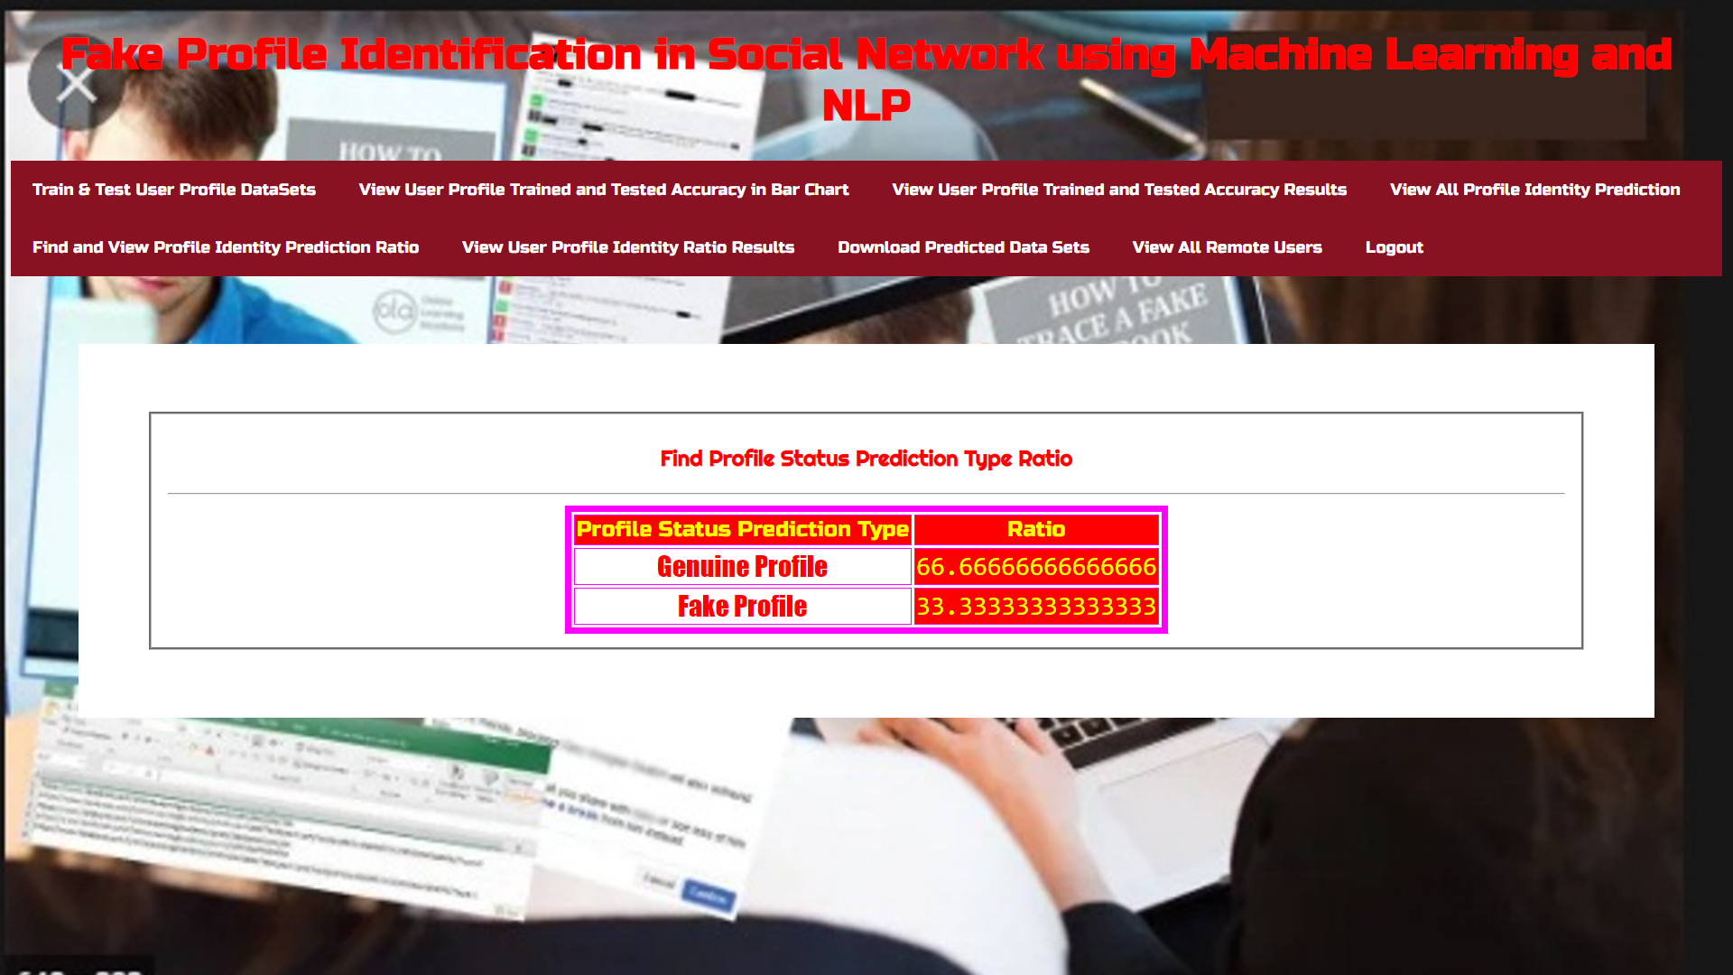
Profile Status Prediction Type Ratio :-

Slide 29
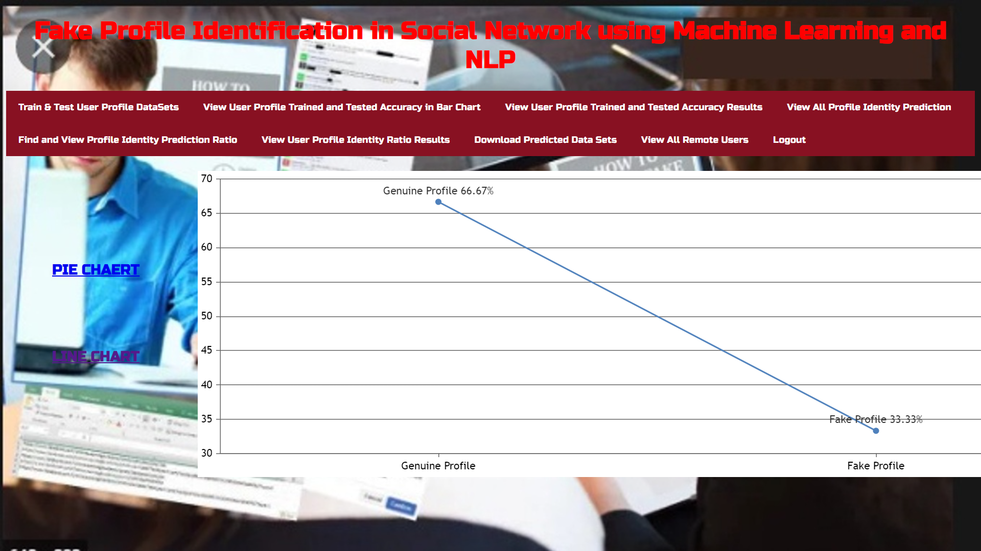
Profile Status Prediction Type Ratio In Line Chart :-

Slide 30
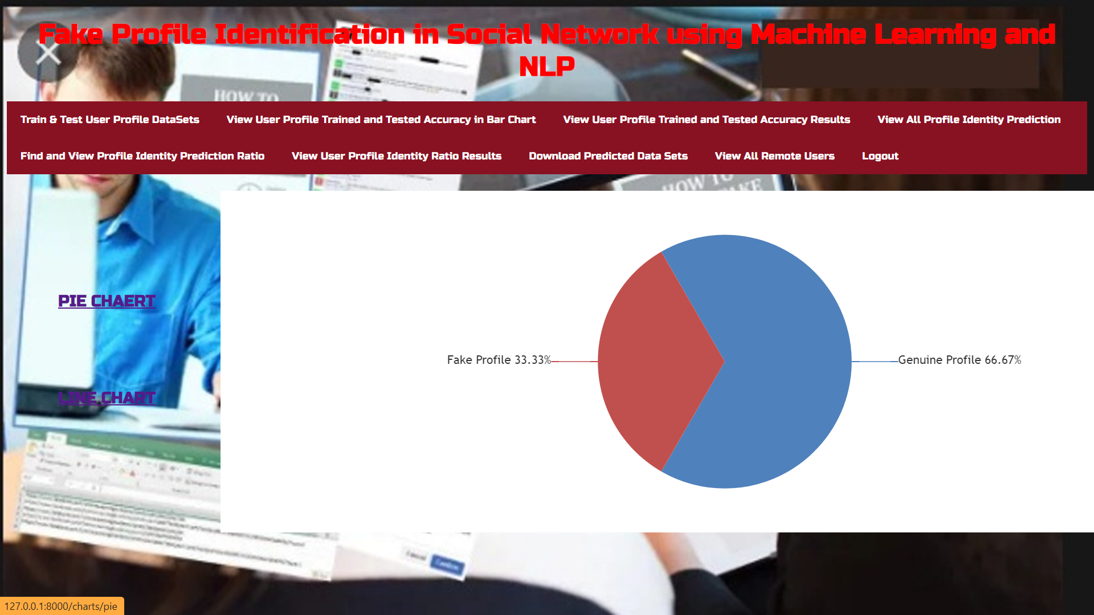
Profile Status Prediction Type Ratio In Pie Chart :-

Slide 31
CONCLUSION
In the conclusion, using machine learning algorithms along with natural language processing techniques , we can easily detect the fake profiles from the social network sites. The NLP pre-processing techniques are used to analyze the dataset and machine learning algorithm such as SVM and Naive Bayes are used to classify the profiles. These learning algorithms are improved the detection accuracy rate in this project.

Slide 32
Future scope
The future scope in Fake Profile Identification using ML and NLP involves refining ML models, exploring advanced features like user behavior analysis, and implementing dynamic learning for threat adaptation. Real-time monitoring, cross-platform integration, privacy emphasis, and regulatory compliance are key focus areas, ensuring a secure social networking environment.

Slide 33
References
[1] Michael Fire et al. (2012). "Strangers intrusion
detection-detecting spammers and fake profiles in social networks based on topology anomalies." Human Journal 1(1): 26-39.Günther, F. and S. Fritsch (2010). "neuralnet: Training of neural networks." The R Journal 2(1): 30-38
[2] Dr. S. Kannan, Vairaprakash Gurusamy, “Preprocessing Techniques for Text Mining”, 05 March 2015.
[3] Shalinda Adikari and Kaushik Dutta, Identifying Fake Profiles in LinkedIn, PACIS 2014 Proceedings, AISeL.

Slide 34
THANK YOU!

